Slide 1

CIS 220 ENTERPRISE ARCHITECTURE
Winter Quarter 2012
Project One: Strategic Planning and Business Ecosystem
Team JAST:
Jasmita Maharaj
Althea Kemp
Susy Simanullang
Tim Wilkie

Slide 2

Strategic Planning: History
The origins of strategic planning began in the military, date back to the 6th century BC.
According to Webster’s New World Dictionary, “strategy” is “the science of planning and directing large-scale military operations of maneuvering forces into the most advantageous position prior to actual engagement with the enemy”.
The business usage of the actual term, “Strategic Planning” began in the 1960s, although “strategic management”, primarily rooted in budgetary planning and control, was popularized in the 1950s.
The 1960s ushered in a new era, and strategic positioning rose to prominence in corporate America.
During the 1980s General Electric’s Chairman, Jack Welch, became highly influential and equally controversial in the world of strategic management.
JACK WELCH’S SIX RULES
Control your destiny, or someone else will.
Face reality as it is, not as you wish it were.
Be candid with everyone.
Don’t manage, lead.
Change before you have to.
If you don’t have a competitive advantage, don’t compete.

Slide 3
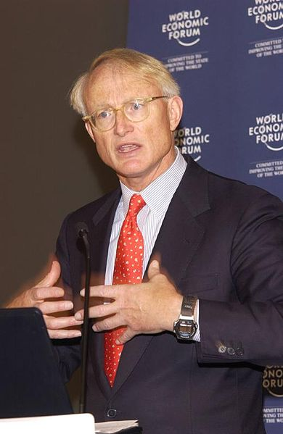
MICHAEL PORTER
In 1980, Harvard Professor and strategic planning guru, Michael Porter, wrote the groundbreaking book, “Competitive Strategy” on the topic of strategic planning.

Slide 4

Strategic Planning
Strategic Planning deals with at least one of the three key questions.
“What do we do?”
“For whom do we do it?”
“How do we excel?”

Slide 5
Why should an organization do strategic planning?
The primary motive for organizations to do strategic planning is to learn and to make decisions about the future of the organization based on that learning. There are many specific reasons for an organization to initiate a strategic planning process, including the following:
To give the organization better control over external forces
To serve as a tool for decision making and resource allocation
To bring everyone together in the organization so that they are on the same wavelength
To raise board members’ awareness of current issues and operations
To reawaken and motivate key people within the organization
To position the agency for a merger or joint venture
To create a document suitable for fundraising and public relations
To increase morale within an organization and develop a sense of trust and cohesion
To set the stage for the organization to make a "quantum leap" to a new level of program development or functioning
To relate organizational capacity to community need.

Slide 6
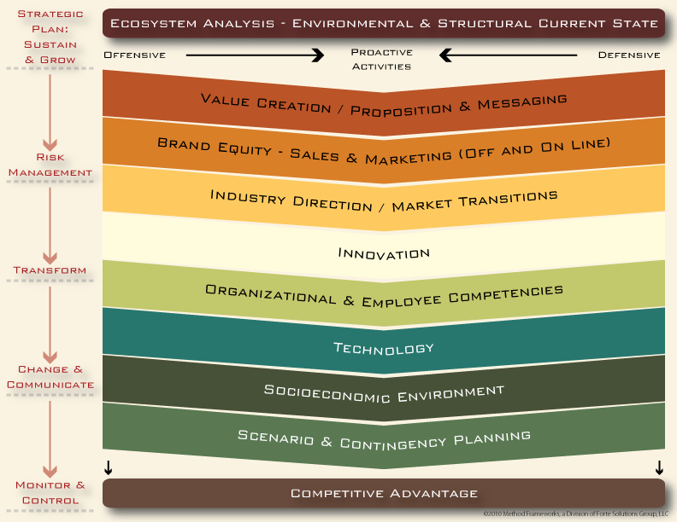
Elements of Strategic Planning

Slide 7
Benefits of Strategic Planning
Strategic planning serves a variety of purposes in organizations, including to:
Clearly define the purpose of the organization and to establish realistic goals and objectives consistent with that mission in a defined time frame within the organization’s capacity for implementation.
Communicate those goals and objectives to the organization’s constituents.
Develop a sense of ownership of the plan.
Ensure the most effective use is made of the organization’s resources by focusing the resources on the key priorities.
Provide a base from which progress can be measured and establish a mechanism for informed change when needed.
Listen to everyone’s opinions in order to build consensus about where the organization is going.
Provides clearer focus for the organization, thereby producing more efficiency and effectiveness.
Bridges staff/employees and the board of directors (in the case of corporations).
Builds strong teams in the board and in the staff/employees (in the case of corporations).
Provides the glue that keeps the board members together (in the case of corporations).
Produces great satisfaction and meaning among planners, especially around a common vision.
Increases productivity from increased efficiency and effectiveness.
Solves major problems in the organization.

Slide 8

Strategic Planning – Models
VISION STATEMENT, MISSION STATEMENT, VALUES, STRATEGY,
GOALS AND OBJECTIVE
Vision Statement: outlines what the organization wants to be, or how it wants the world in which it operates to be (an "idealized" view of the world).
Our vision serves as the framework for our Roadmap and guides every aspect of our business by describing what we need to accomplish in order to continue achieving sustainable, quality growth.
People: Be a great place to work where people are inspired to be the best they can be.
Portfolio: Bring to the world a portfolio of quality beverage brands that anticipate and satisfy people's desires and needs.
Partners: Nurture a winning network of customers and suppliers, together we create mutual, enduring value.
Planet: Be a responsible citizen that makes a difference by helping build and support sustainable communities.
Profit: Maximize long-term return to shareowners while being mindful of our overall responsibilities.
Productivity: Be a highly effective, lean and fast-moving organization.
Mission Statement: defines the fundamental purpose of an organization or an enterprise, succinctly describing why it exists and what it does to achieve its vision. Here is an example of a mission statement for The Coca-Cola Company:
Our Mission: The Coca-Cola Company
Our Roadmap starts with our mission, which is enduring. It declares our purpose as a company and serves as the standard against which we weigh our actions and decisions.
To refresh the world...
To inspire moments of optimism and happiness...
To create value and make a difference.

Slide 9
VISION STATEMENT, MISSION STATEMENT, VALUES, STRATEGY,
GOALS AND OBJECTIVE
Values: beliefs that are shared among the stakeholders of an organization. Values drive an organization's culture and priorities and provide a framework in which decisions are made
Live Our Values:
Our values serve as a compass for our actions and describe how we behave in the world.
Leadership: The courage to shape a better future
Collaboration: Leverage collective genius
Integrity: Be real
Accountability: If it is to be, it's up to me
Passion: Committed in heart and mind
Diversity: As inclusive as our brands
Quality: What we do, we do well
Strategy: narrowly defined, means "the art of the general." A combination of the ends (goals) for which the firm is striving and the means (policies) by which it is seeking to get there. A strategy is sometimes called a roadmap which is the path chosen to plow towards the end vision. The most important part of implementing the strategy is ensuring the company is going in the right direction which is towards the end vision.
Goals – goals are broad based strategies needed to achieve your organization’s mission.
Objectives – objectives are specific, measurable, action oriented, realistic and time bound strategies that achieve the organization’s goals and vision.

Slide 10
tools

Slide 12

Strategic Planning Video
http://www.youtube.com/watch_popup?v=1ME25QEbLJc&vq=medium

Slide 13
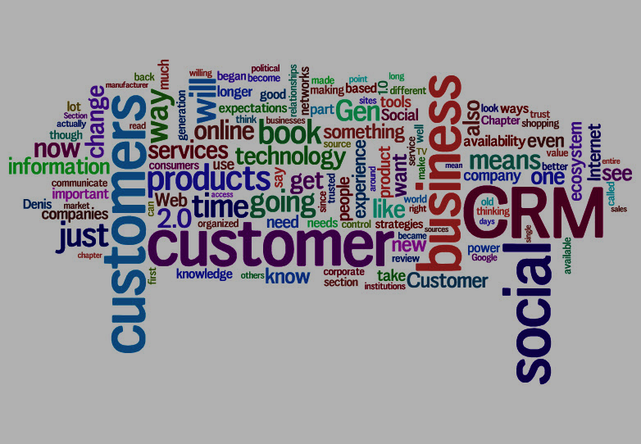
Business Ecosystems

Slide 14
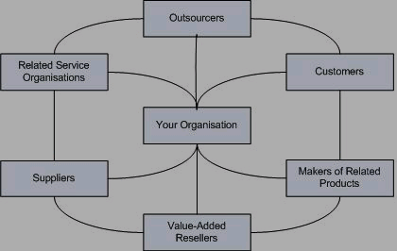
What is
Business
Ecosystem?

Slide 15
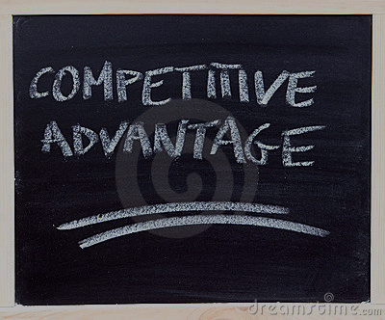
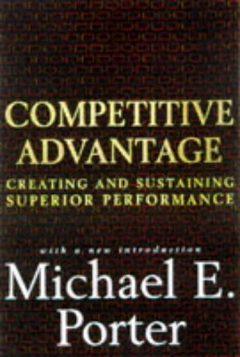

Business Ecosystem
Origin

Slide 16
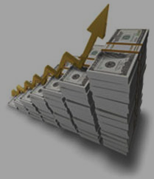

1.Customer Loyalty
2. Differentiation from competitors
3. Increased Revenues

Slide 17
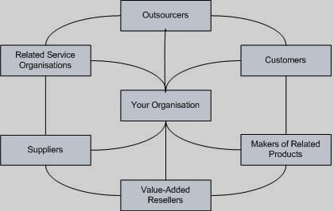
Key Differences

Slide 18
http://www.youtube.com/watch_popup?v=-aa-MWP2F4o&vq=medium
http://www.youtube.com/watch_popup?v=-aa-MWP2F4o&vq=medium

